Slide 1
TARGET MARKERS SAFETY AND ADMINISTRATION BRIEFING
National Shooting Centre

Slide 2
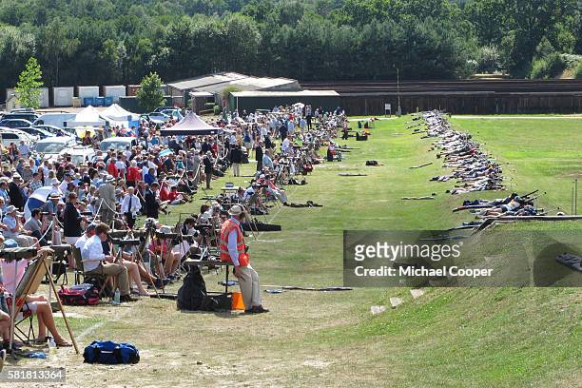
Briefing Content
Overview
Supervision
Safety Signs
Danger Areas
Access & Egress
Bullet Trajectory
Splash back, Ricochet, & Debris
Target Mechanisms
Other Hazards
Emergencies
Marking
Radio Communication
Vandalism, Alcohol and Drugs
PPE

Slide 3
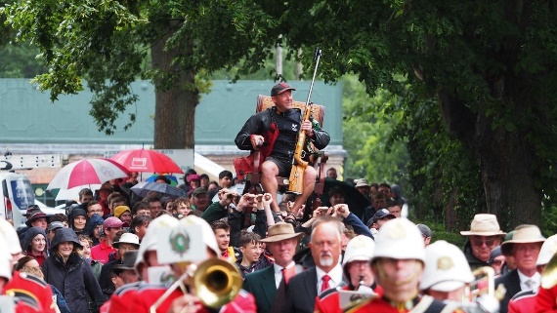
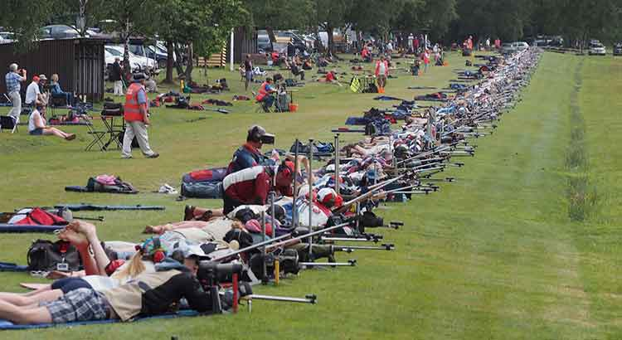
-National Shooting Centre
-Europe's largest Shooting Complex
-Charitable Status – The NRA is the Charity side of things, whereas the National Shooting Centre is the business. King Charles is our Patron.
-International Shooters – Our annual Imperial competition sees shooters travel from all over the world.

Slide 4
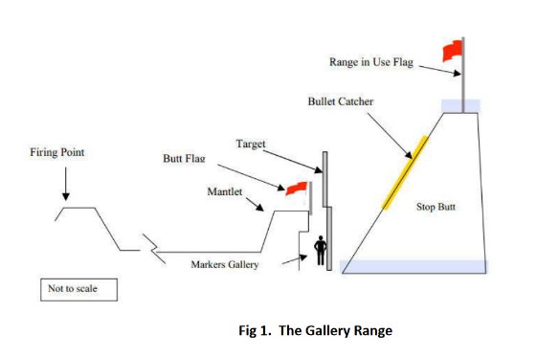
Overview
Requirements for physical marking of targets
Layout of a Gallery Range (a range with a raised firing point and raised targets)

Slide 5
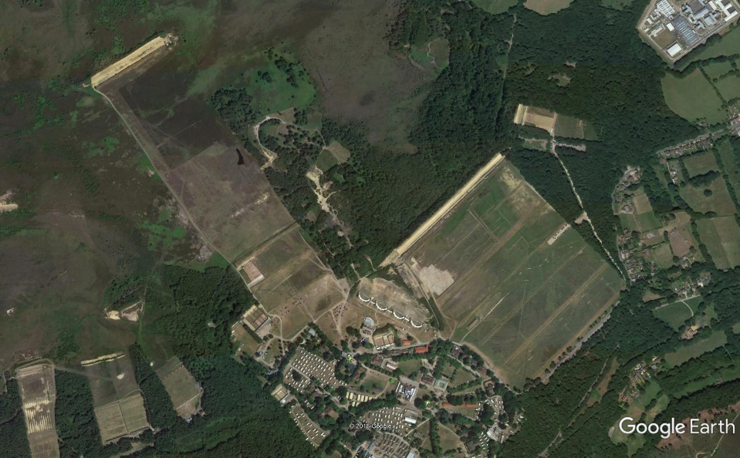
STICKLEDOWN LONG RANGE
SHORT SIBERIA
CENTURY

Slide 6
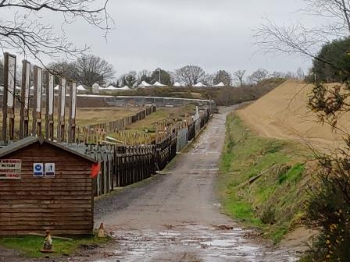
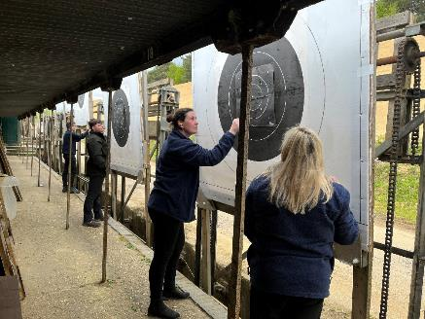
Century Butts
-108 lanes (one of the largest single full-bore ranges in the world)
-Distances 100x to 600x

Slide 7
Short Siberia Butts
-27 lanes
-Distances 100x to 200x
-Smaller, lighter, newer targets=. Different type of counter-balance.

Slide 8
Stickledown Butts
- 50 lanes
- Distances 800x to 1200x (over two thirds of a mile)
- Larger target frames – no requirement to change target
-Locked in range until end of shooting due to other range danger areas
-Entry times latest at 0815 and 1315
-Meeting point at 1000x gate

Slide 9
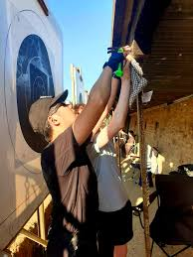

Slide 10
Supervision
Always people available to offer support/assistance:
Butts Supervisor (Busy periods)
Range Office – “Control” (Channel 16)
Range Safety Supervisors
Range Officers (Firing Point)
Target Shed / Electronic Team

Slide 11
Safety

Slide 12
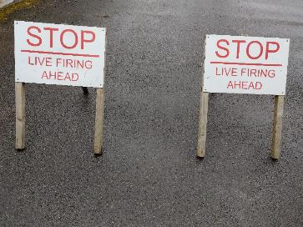
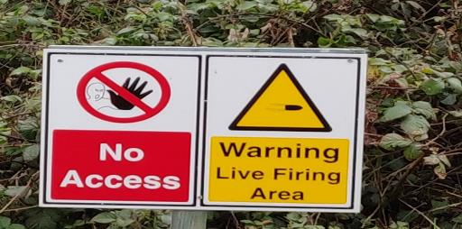
SAFETY SIGNS

Slide 13
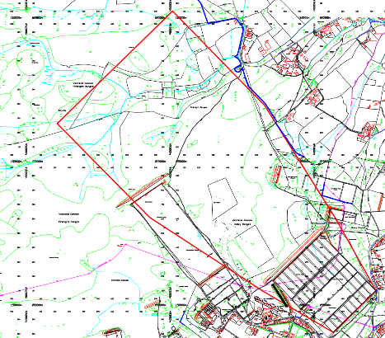
Live Fire/Danger Areas
Multiple ranges on Bisley camp firing at any one time
Do not go on the sand bank even if shooting has finished on your lane
Range Danger area is 2900m
SAFE WORKING
Stay under the mantlet at all times – Even after shooting.
If unsure ask control if clear to enter areas

Slide 14
Access and Egress Routes Overview of Markers Walkway

Slide 15
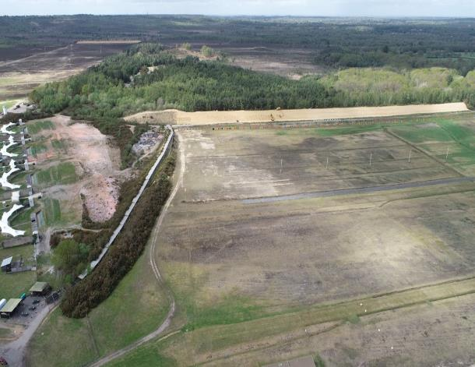
Access and Egress Routes Entrance to Century Butts

Slide 16
Entrance to Short Siberia Butts
Either via Century Butts and turn left at the end
Or, Drive round the back of Century 600yrds Firing Point (Hobsons Way)

Slide 17
Bullet Trajectory
The diagrams to the left demonstrate the line of travel of a bullet that has been accurately fired in the centre of the target. The red area shows the area of which is not safe.
REMEMBER – The diagrams show one bullet route; a safe route where the shooter has hit the centre of the target. There are thousands of possible routes that bullet could take. Also, there is always a possibility of an ammunition problem, rifle issue, or user issue that can lead to an unsafe line of travel for the bullet (see next slide).

Slide 18
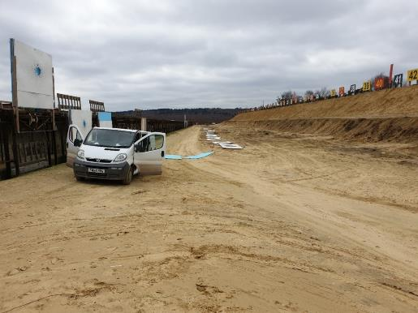
Bullet Trajectory
The image to the left shows how low a shot can go. This can be down to rifle issues, ammunition issues, user problems etc.
The image to the right shows a bullet striking a wooden or metal part of the frame due to dangerously low shooting. This has caused the bullet to ricochet, and the bullet to split into smaller pieces, called bullet fragments. Bullet fragments are just as dangerous as a bullet itself. Overall, based on the diagrams, the only place you are safe is under the mantlet. The mantlet will give you protection against everything you can see above.
NRA staff are able to work on some ranges on the dirt track road, as they have had the necessary training.

Slide 19
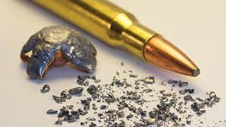
Splashback & Ricochet
Splashback from the sand bank if on shorter ranges. Helps you notice if a shot has been fired, and whereabouts that shot has roughly gone.
Ricochet from shots falling short (hitting the mantlet and tumbling over) or from striking objects as mentioned in previous slide.
SAFE WORKING
Stay under mantlet at all times
Eye protection is recommended. Hearing protection is mandatory.

Slide 20
Debris & Noise
Loud environment
Debris if bullet strikes wooden structure of target frame – using handheld targets
SAFE WORKING
PPE – can be provided at the range office

Slide 21
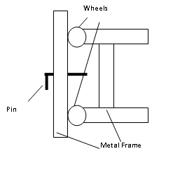
Target Mechanisms
Target frames are heavy
If operated incorrectly, they can cause injuries
SAFE WORKING
Ensure the locking pin is inserted between wheels of target mechanism
If unsure, always seek assistance

Slide 22
Slips, Trips and Falls
Ground can be uneven in places
Trough
Litter – DO NOT LITTER. It is important you clean up, as a trip hazard can lead to a visit head first into the trough, which is not desirable.
SAFE WORKING
Appropriate footwear (No open toe shoes)
Pay attention to where you are walking
Report any hazards

Slide 23
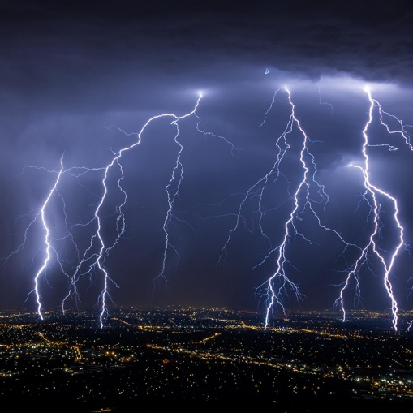
Weather
With heavy wind or lightning (extreme weather), Range Safety and Range Control will monitor the weather and decide whether or not it would be safe to continue.
SAFE WORKING
Range Safety monitor and will stop shooting if necessary
Ensure enough layers for winter
Plenty of water in summer

Slide 24
Emergencies
Use radio – Channel 16 for Range Control
Contact for assistance (inc first aid required)
If you see anything happen in the butts that pose an immediate threat to life or severe injury, contact control on channel 16 immediately.
Emergency stop procedure
4, quicker sounds of the hooter at unusual times
Lower your target, await further information

Slide 25
MARKING

Slide 26
How to Insert a Target Into a Frame
Ensure correct size target for the distance being shot (target size is indicated in small print on the bottom right corner of the paper)
Slide target up into frame, ensuring it catches the top board and then slide into the retaining boards on the bottom corners of the frame.

Slide 27
How to Put a Target Into a Frame

Slide 28
How to Remove a Target From a Frame
Ensure the locking pin has been inserted between the wheels of the frame before removing the target
When removing the target frame, lower it gently on to the ground, do not drop it!
Once the target has been removed, remove the target face and place it in the target bins provided. The blank screen also needs to be returned to where it was picked up from.

Slide 29
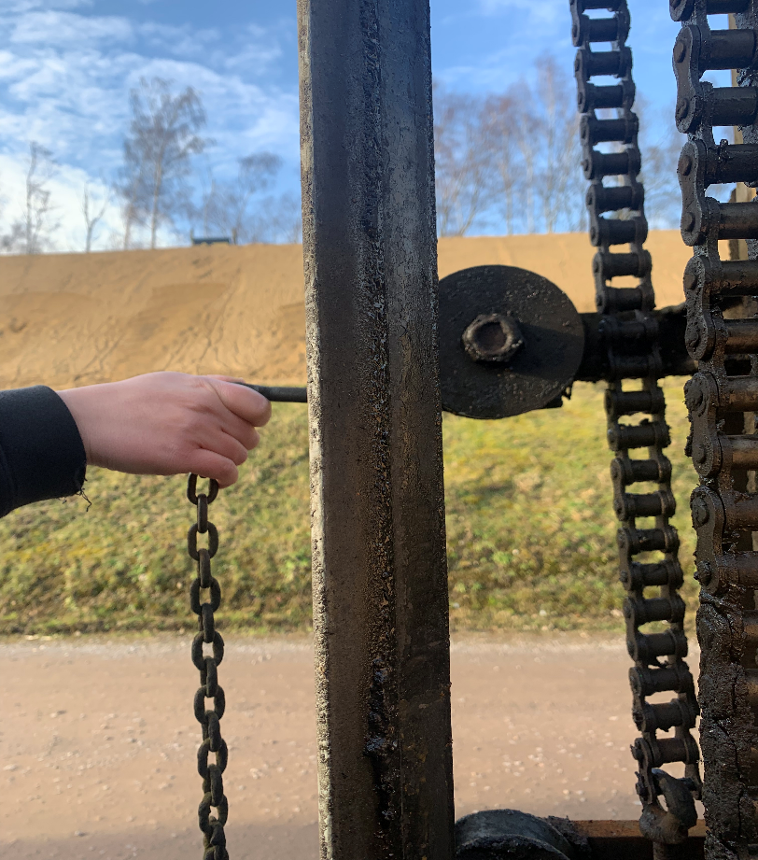
Locking Pin
We must stress you should always ensure the locking pin is in place when removing the target for your own safety

Slide 30
How to Remove a Target from a Frame

Slide 31
How to change a target face (pin-ons)
For pin-on targets, fit the target face to the blank screen using the plastic nuts and bolts provided
Ensure the locking pin is between the wheels of the frame before fitting the face on.
Once the pin-on is tightly fitted, remove the locking pin and raise the target.
Please note Stickledown frames can’t be removed so only changing the face is necessary.

Slide 32
Changing a Pin-on
Safety Elements:
On Stickledown, this is a two person job, make sure there is someone around to help
Beware of your footing at all times, specifically when reaching over the trenches
Make sure the safety pin is placed correctly before doing anything

Slide 33
Black stickers on the black, white stickers on the white
Marking board and appropriate sized spotting disc
Small disc for 300yds or less
Large disc for 500yds+
All rubbish is to be put into the bins provided
If you are struggling or have any questions while you are marking, either ask the butts supervisor or another marker. We are all one team!

Slide 34
Marking

Slide 35
Scoring
Here’s a tip – ask for a pen and write the numbers along the bottom so you can remember what score cards go where. The supervisors can show you this when you get down in the butts!
1
2
3
4
5
V
1
2
3
4
5
V

Slide 36
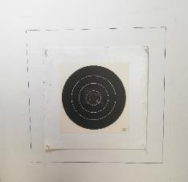
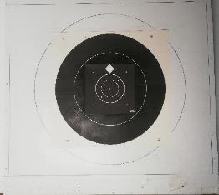
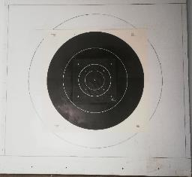
Types of Targets
300x (pin on) 500x 600x
F Class – same premise, but smaller circle rings
Just count from the middle ring outwards for scoring

Slide 37
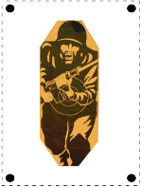
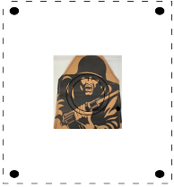
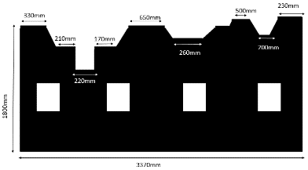
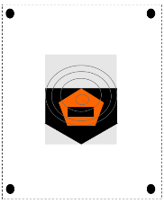
Other Types of Marking
Other targets
McQueen Castles

Slide 38
Competition Marking
Team competitions. You will be given a brief by the shooter/Range Officer (person who supervises the shooters) about the course of fire (type of shooting and how many shots/how long etc.) Example:
Some shooting events will have a structure.
“2 and 10, 3 shooters per target, 3 details”
2 being the practice shots, and 10 being the scoring shots (shots that get scored overall)
In this case, there would be a maximum of 36 shots per detail (12 shots x 3 details = 36 shots)
3 details means 108 shots (3 details x 36 shots)

Slide 39
Radio Communication
Channel 16 for Range Control
Channel 1 – Firing point ←→ Butts (private channel)
Any problems inform control/supervisor
Be Polite
Be Clear
Be Precise
Try and assist if they miss the target
You can ask for one of these cards in the office
Go on the range and test and practice together

Slide 40
Radio Terminology
‘Over’ – You have finished your message and are expecting a reply
‘Out’ – You are ending the conversation and are not expecting a reply
‘Go ahead’ – You are ready to receive a message
‘All Received’ – You have heard and understood the previous message clearly
‘Radio Check’ – Checking that the other user(s) on your channel can hear you
Please remember with each message to control that you introduce yourself with what range and target number you are on, this allows control to pass information on quickly and get help or assistance to you sooner, for example:
“Target 48 Century to Control, over”..

Slide 41
Radio Communication Example
Talking on the Control Net (channel 16):
Marker - “Hello Control, this is Century target 56 butts. Over”.
Control – “This is Control, go ahead”
Marker – “Control, this is Century target 56 butts. I am running low on patches, would it be possible to have more sent down? Over”
Control – “This is Control, all received. Someone is on their way to you now. Out”

Slide 42
Radio Communication Example
Some shooters will talk over the radio in a more relaxed sense. However, when on the control net, please keep to the communications as stated in the previous slide.
Talking to the shooter at the firing point (channel 1):
Shooter – “Century target 56 from Firing Point. Over.”
Marker – “Target 56 butts, go ahead. Over”
Shooter – “Target 56, message one. Over.”
Marker – “Target 56 Butts, all received. Out.”

Slide 43
Training Assessment
TIME TO PRACTICE
Assessment later
Time to mark 10 shots (average of below 15 seconds per shot where possible)
Understanding of messages
Understanding of targetry and scoring

Slide 44
Pay Rates As of April 2025
You will be paid only for the hours that you actually work under an assignment (4 hours for AM, 4 hours for PM). If your shooter finishes early, you will still be paid 4 hours.
For staff under 21, The NRA’s current rate of pay for casual markers is £11.70 per hour (gross). This hourly sum comprises two elements:
£10.44 in respect of basic pay; and
An additional £1.26 in respect of statutory entitlement to paid leave.
For staff aged 21 and over, the rate of pay for casual markers is £13.68 per hour (gross). This hourly sum comprises two elements:
£12.21 in respect of basic pay; and
An additional £1.47 in respect of statutory entitlement to paid leave.
The rate for Marker Supervisors is £14.50per hour (gross). This sum comprises:
£12.94 in respect of basic pay; and
An additional £1.56 in respect of statutory entitlement to paid leave.
Work on Sundays = an additional £1.00 per hour

Slide 45
How To Book Work
Email: markers@nra.org.uk on Monday for work the following weekend (not that coming weekend). For example, email us stating availability (different emails for weekdays and weekends), on Monday 8th for Saturday and Sunday the 20th+21st. Follow the same two week in advance pattern for the weekday shifts (17 or over except from School Holiday’s), and you will pick some shifts up. Please note this is first-come first-served.
If you cannot make your work at short notice then you may ring us on 01483 797777 Ext 151/ Ext 152.
This number must NOT be used for booking work as the line gets extremely busy with Range bookings. If you attempt to use this number to book work, you will not get put on the marker list.
Email in if interested in working Imperial. Opportunity to work a couple of weeks in the summer with your friends, and to possibly earn up to (approx.) £1000. Please also see sign-up forms.

Slide 46
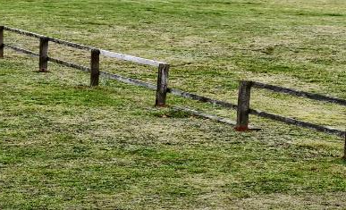
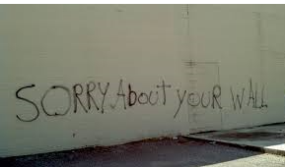
Vandalism, Alcohol and Drugs
Zero Tolerance

Slide 47
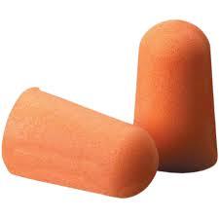
PPE
Hearing protection is mandatory and can be provided by the Range Office. Noise cancelling headphones are permitted, however we recommend that you use adequate, specific protection.
Appropriate footwear (no open toes). Old clothes are also recommended, as the targets can get dirty.
Safety glasses required for McQueen marking. They can be found (along with hearing protection) inside your McQueen box’s.

Slide 48
Remember – be safe
If you are not sure, ask!

