Slide 1

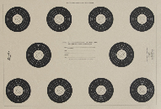
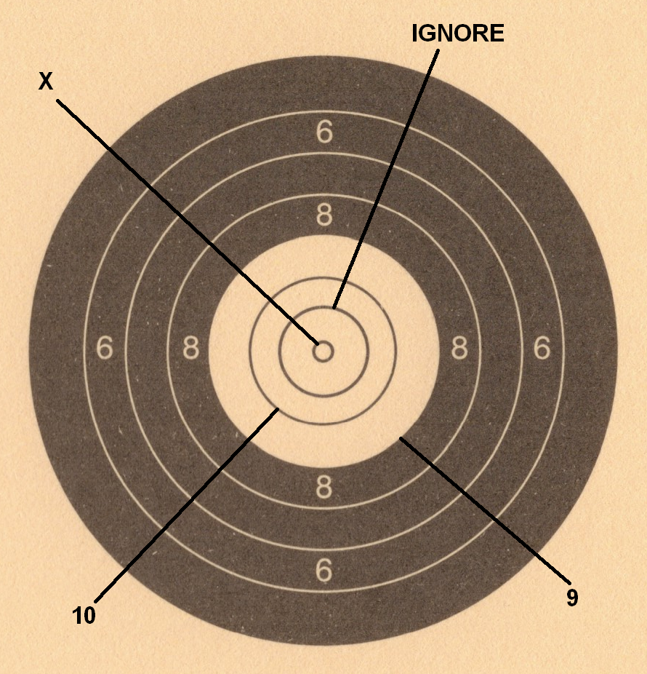
RO Event Crib Sheet
Gallery Rifle & Pistol
V1 (2025) 50m Precision Benched
Time: 45 mins | Distance: 50m
Course of Fire |  | Box Settings
Sighters: Unlimited shots in 5 minutes Shooters to examine targets, ROs reface |  | 5 mins with 5 secs away time
Practices 1 & 2: 10 shots in 5 minutes GRSB: 1 Shot per diagram GRCF: 2 Shots per diagram ROs score and reface |  | 5 mins with 5 secs away time
Practice 3: 10 shots in 5 minutes GRSB: 1 Shot per diagram GRCF: 2 Shots per diagram ROs score, cards completed & collected |  | 5 mins with 5 secs away time
Notes:
Gun type Event number & Card colour | GRSB | GRCF | Handguns
 | 0401 | 0402
 |  | 0403 Open
 |  | 0404 Classic
Target | NSRA 25 Yard Benchrest | NRA GR5
Sights | Any – as per gun type | Any | Any | Irons
 | Spotting Scopes may be used
Rounds | 30 + sighters | 30 + sighters | 30 + sighters | 30 + sighters
Max. Score | 300 | 300 | 300 | 300
Ready Pos. | Benched | 45 degrees | 45 degrees | 45 degrees
Position | Benched | Standing unsupported | Standing unsupported | Standing unsupported
Penalties | No event specific penalties
Range Commands
NSRA 25 Yard Benchrest Scoring
B6.9.1: Competitors fire from a seated position using a bench or table. The fore-end stock of the rifle is supported either by a bipod (attached to the rifle) or by a rest (not attached to the rifle). A rest may be positioned anywhere along the fore-end of the rifle but must not support more than 100mm (4”) of the length of the fore-end. The butt of the rifle must be in the firer’s shoulder and not supported in any way by the table or bench or by any other device. The non-firing hand may not be touching the rifle or the bipod / rest when the trigger is pulled. The elbow of the firing arm may rest on the bench or table.
NB: All scoring is inward gauging for these events.
“SHOOTERS TO THE LINE”…. “UNBAG AND SHOW CLEAR” – ROs check each firearm is clear
CRO reads out the Course of Fire and checks understanding
“CHECK AND ADJUST” – shooters may check their firearms and adjust their sights onto the target
Having checked that the range is clear and shooters appear ready, the CRO commands “LOAD AND MAKE READY”. Having given time to load and make ready, the CRO commands “ARE YOU READY?” Silence will be taken as agreement – any competitor who is not ready may raise one arm, after which the CRO will confirm “NOT READY CALLED” and repeat until silence.
“STAND BY” Targets turn away and face after 5 seconds, or where the targets do not turn, a whistle may be blown (or other audible signal made) to signal shooting may begin.
When the targets turn away or the whistle is blown, firing must cease immediately. CRO will command “UNLOAD AND SHOW CLEAR”.
When all ROs have reported clear, the CRO will command “RANGE IS CLEAR” and give permission to ROs and Competitors to go forward in order to score and replace targets as necessary. Competitors must not start picking up their gear until this command is given.
“STOP, STOP, STOP” – On hearing this command all competitors must cease shooting immediately and keep the gun pointing in a safe direction, keep their finger away from the trigger and wait for further instructions (note that anyone on the range can, and should, call “STOP, STOP, STOP” if they become aware of any potential safety issue.

